Slide 1
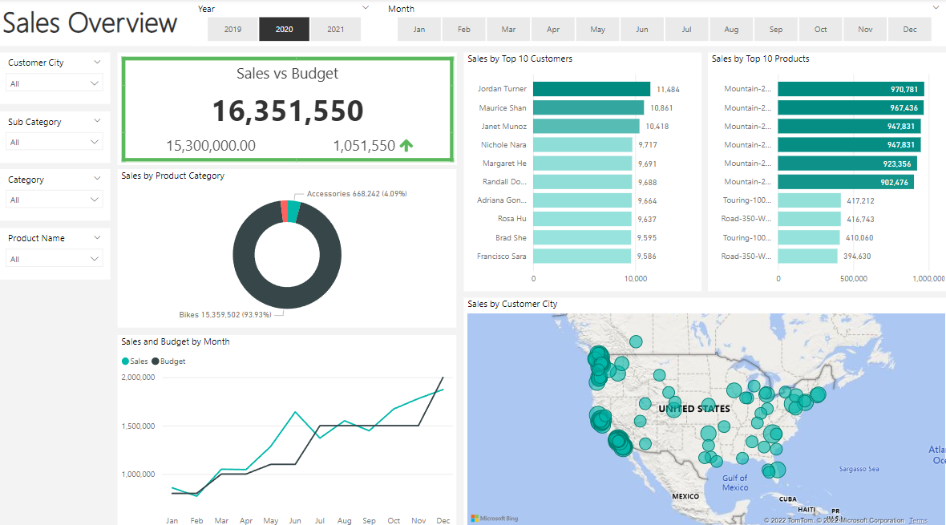
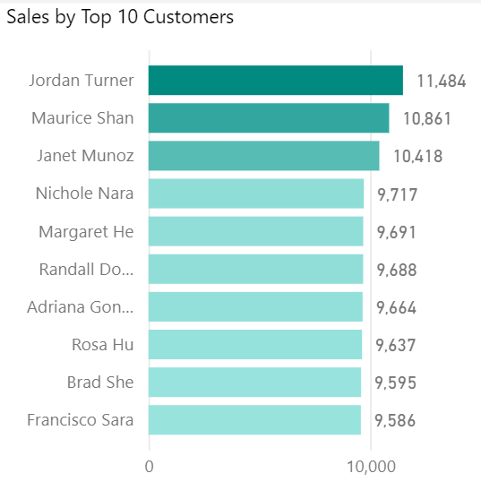
Data Analyst Portfolio Project Sales Management
PRAKHAR BHARDWAJ
MS MECHANICAL ENGINEERING
CARNEGIE MELLON UNIVERSITY

Slide 2
Business Request & User Stories
No # | As a (role) | I want (request/demand) | So that I (user value) | Acceptance Criteria
1 | Sales Manager | To get a dashboard overview of internet sales | Can follow better which customers and products sell the best | A Power BI dashboard that updates data once a day
2 | Sales Representative | A detailed overview of Internet Sales per Customers | Can follow up with my customers that buy the most and to whom we can sell more to | A Power BI dashboard that allows me to filter data for each customer
3 | Sales Representative | A detailed overview of Internet Sales per Products | Can follow up my Products that sell the most | A Power BI dashboard that allows me to filter data for each Product
4 | Sales Manager | A dashboard overview of internet sales | Follow sales over time against budget | A Power Bi dashboard with graphs and KPIs comparing against the budget.
The business request for this data analyst project was an executive sales report for sales managers.
Based on the request that was made by the customer following user stories were defined to fulfill delivery and ensure that the acceptance criteria were maintained throughout the project.

Slide 3
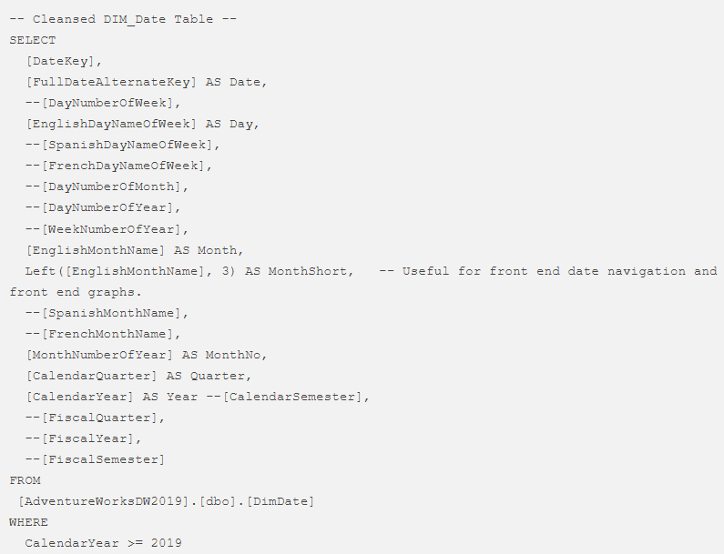
Data Cleansing & Transformation (SQL)
To create the necessary data model for doing analysis and fulfilling the business needs which were defined in the user stories the following tables were extracted using SQL.
One data source (sales budgets) was provided in Excel format and was connected to the data model in a later step of the process.
DIM_Calendar

Slide 4
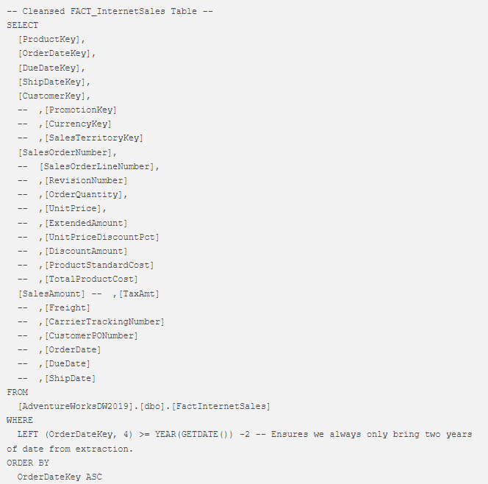
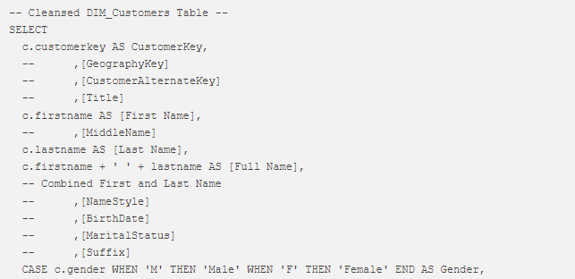
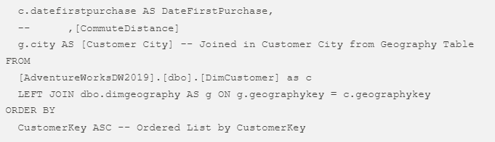
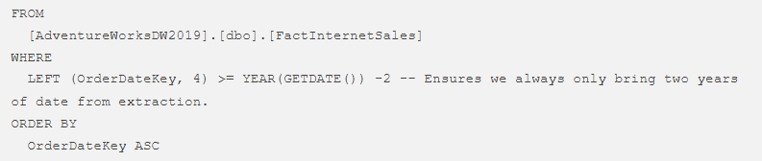

FACT_InternetSales
DIM_Customers

Slide 5
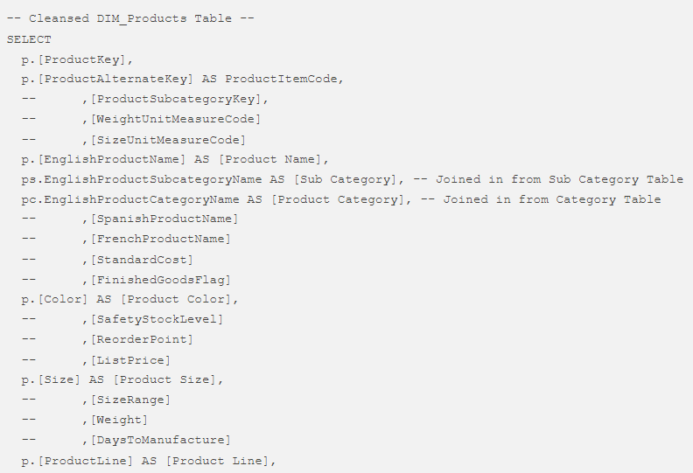
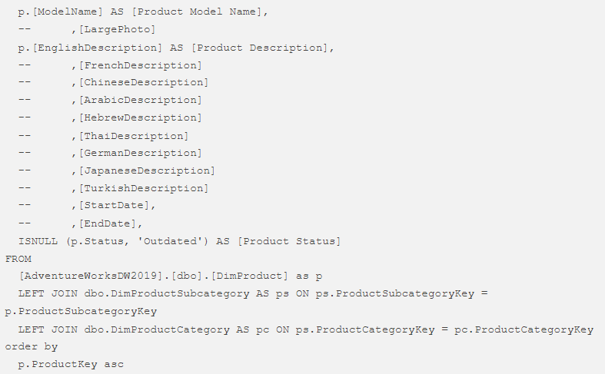

DIM_Products

Slide 6

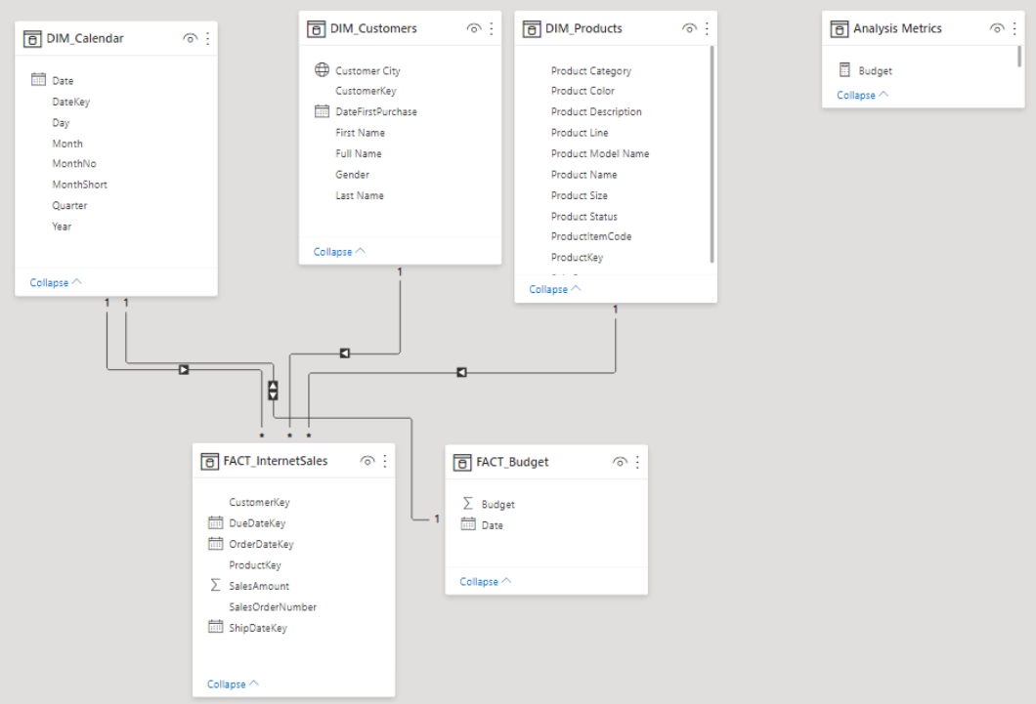
Data Model
.
On the side is a screenshot of the data model after cleansed and prepared tables were read into Power BI
This data model also shows how FACT_Budget has been connected to FACT_InternetSales and other necessary DIM tables

Slide 7

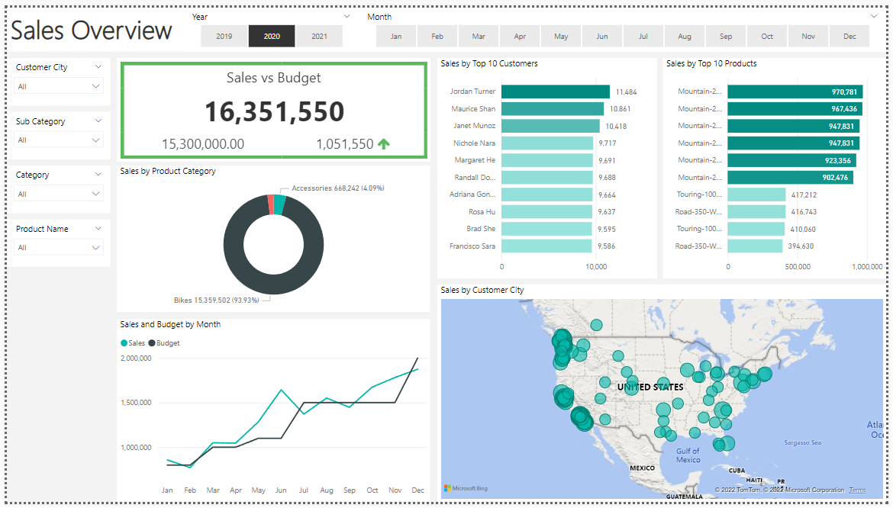
Sales Management Dashboard

Slide 8
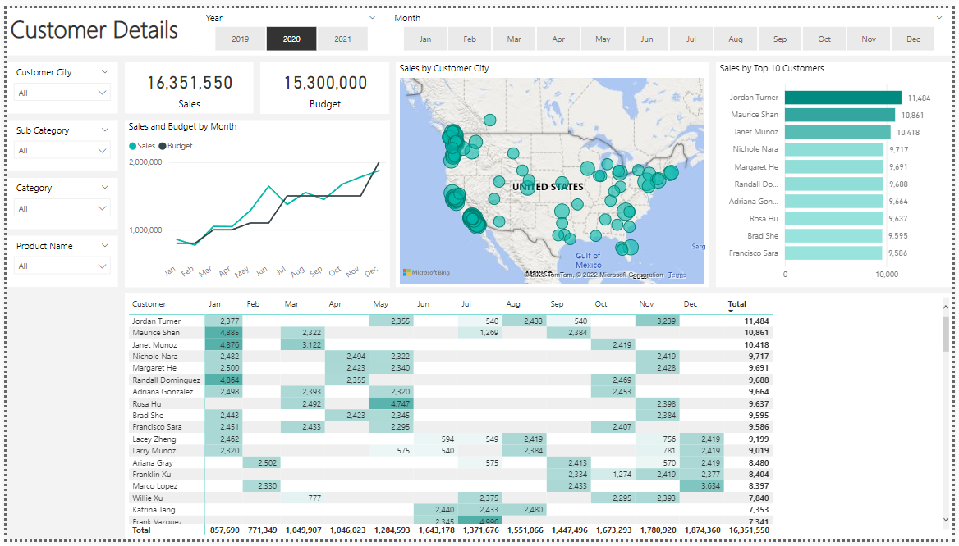
Sales Management Dashboard

Slide 9
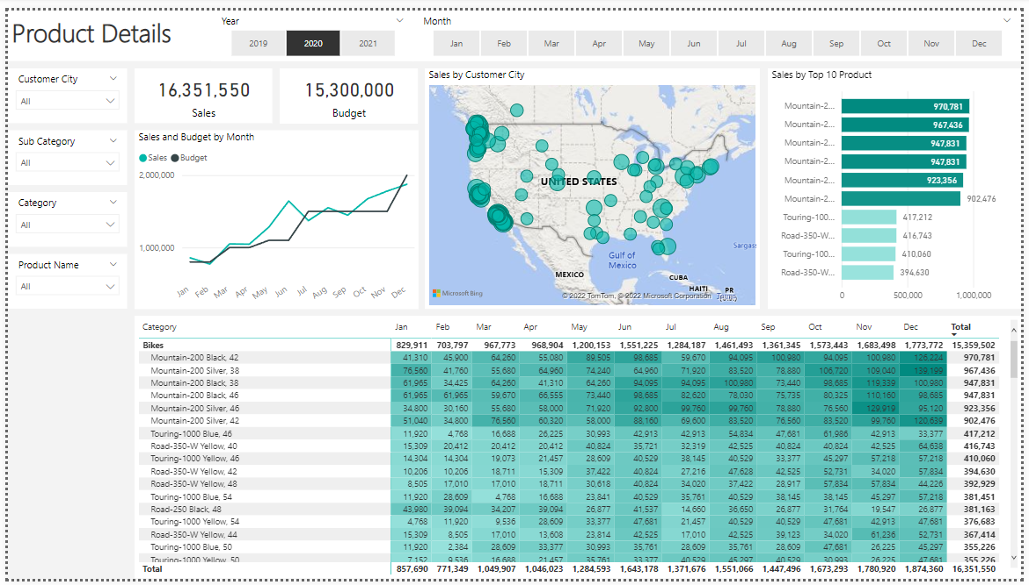
Sales Management Dashboard

